Slide 1
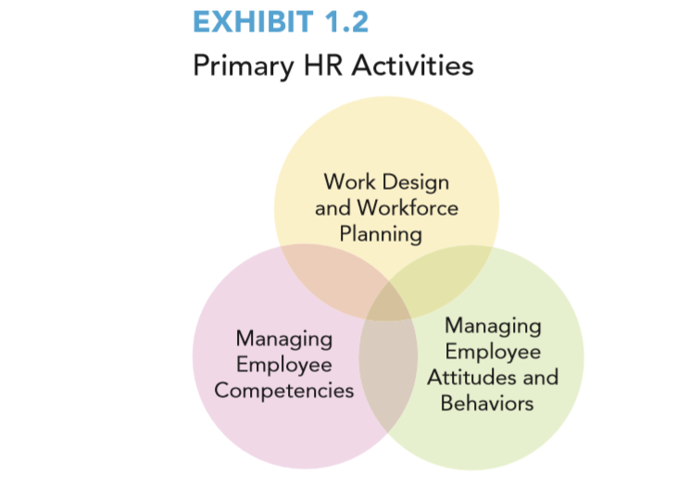
Notes:
Long Description: The diagram is titled EXHIBIT 1.2, primary HR activities. The primary activities are shown in three overlapping circles. The activities mentioned in the circles are given as follows: Work Design and Workforce Planning, Managing Employee Competencies, Managing Employee Attitudes and Behaviors.

Slide 2
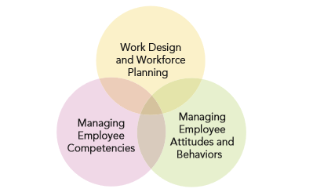
Primary H R Activities: Work Design and Workforce Planning
Focus:
Design jobs in a way that ensures that employees perform tasks and responsibilities that have the most potential to add value to the company
Ensure the right people are in the right place in the company, at the right time, to meet company goals.
Common H R Practices:
Job Design
Workforce Planning
Notes:
Long Description: The primary activities are shown in three overlapping circles. The activities mentioned in the circles are given as follows: Work Design and Workforce Planning, Managing Employee Competencies, Managing Employee Attitudes and Behaviors.

Slide 3
Workforce Planning
Determining the number of employees needed is an ongoing and challenging activity
Deciding how to allocate employees – through promotions, demotions, and transfers
Demand is influenced by strategic changes (e.g. reorganization of operation, new product/service) throughout a company
Must decide to hire full-time employees, outsource, or use independent contractor/gig workers

Slide 4
Workforce Planning, e.g.
Important decisions include:
How should you address a labor shortage or a labor surplus?
When should you require current employees to work overtime as opposed to hiring additional full-time staff?
When should you outsource work rather than hire new employees?
How might you use gig workers instead of full-time employees?
What can you do to minimize the negative effects of downsizing?
Challenge is to understand when different options are likely to be most effective for each company’s unique situation

Slide 5
Team Thought Starter
Prior to COVID-19 your business employed 20 people. During the pandemic, you were forced to lay-off 12 employees and have 5 others work from home.
Now, February 2023, your business has returned almost to pre-pandemic levels and you need to have those 17 people back to your work. Yet you are having difficulty filling those positions.
What is the problem here?
What are your recommendations to fix this problem?

Slide 6
Primary H R Activities: Managing Employee Competencies
Focus:
Ensure employees have the necessary competencies -- knowledge, skills, abilities, (KSA’s) and other talents -- to effectively perform their tasks and responsibilities
Specific Activities:
Recruitment
Selection
Learning & Development
Notes:
Long Description: The primary activities are shown in three overlapping circles. The activities mentioned in the circles are given as follows: Work Design and Workforce Planning, Managing Employee Competencies, Managing Employee Attitudes and Behaviors.

Slide 7
Recruitment
Process of generating a qualified pool of potential employees and/or encouraging current employees to pursue other positions within the company
Where and how companies recruit influences the type and quality of candidates

Slide 8
Recruitment
Key issues to address in a recruitment strategy:
For what competencies do you recruit?
What groups do you target with your recruitment message?
Do you recruit internally, externally, or both?
How do you decide which sources to use for recruitment?
How do you ensure that you offer an employee value proposition that will attract the right applicants?

Slide 9
Selection
Assessing employee competencies required for a particular job
Choosing the best person available from the assessment outcomes
Key issues include:
How do you generate the information that you need to make an effective, and legal, hiring decision?
Which tests are most effective for identifying employees with high potential?
What questions can and should you ask candidates during an interview?
Who makes the ultimate hiring decision?

Slide 10
Learning and Development
Ensuring new and current employees know the ins and outs of the organization and have the necessary skills to perform their jobs
Includes activities to develop individuals for future positions
Important decisions:
How do you know which employees need to be trained?
How do you design an effective training program?
Which training methods are most effective to meet your needs?
What do professional development plans involve for employees in different roles?
How do you build a culture of learning in the organization?
How do you know if learning and development efforts have been successful?

Slide 11
Performance Management
Communicating performance expectations - Past – Present - Future
Evaluating employee performance relative to the expectations
Providing feedback to employee and professional development opportunities
Critical issues are:
What should be the focus of performance reviews?
What is the best way for you to measure employee performance?
How should you communicate that information to employees?
In addition to performance evaluation, how can managers give employees developmental feedback to improve their performance?
How should you manage poorly performing employees?

Slide 12
Compensation & Incentives
Total compensation = base pay, rewards, and incentive system
Some key questions are:
What factors should you consider when determining the salary range for a job?
• What is the best way to determine how much to pay employees?
• How much of that pay do you guarantee and how much should you base on incentives?
• What types of incentives should you use to encourage the employee attitudes and behaviors the firm wants?

Slide 13
Employee Benefits, Health, and Wellness
Employee benefits, health and wellness programs serve as recruitment and retention tool
Helps ensure the health and well-being of a company’s workforce
Critical issues when considering employee benefits, health, and wellness are:
Which benefit programs are most appropriate for your workforce?
What are the legal requirements regarding benefit programs?
How can you ensure the safety of your employees?

Slide 14
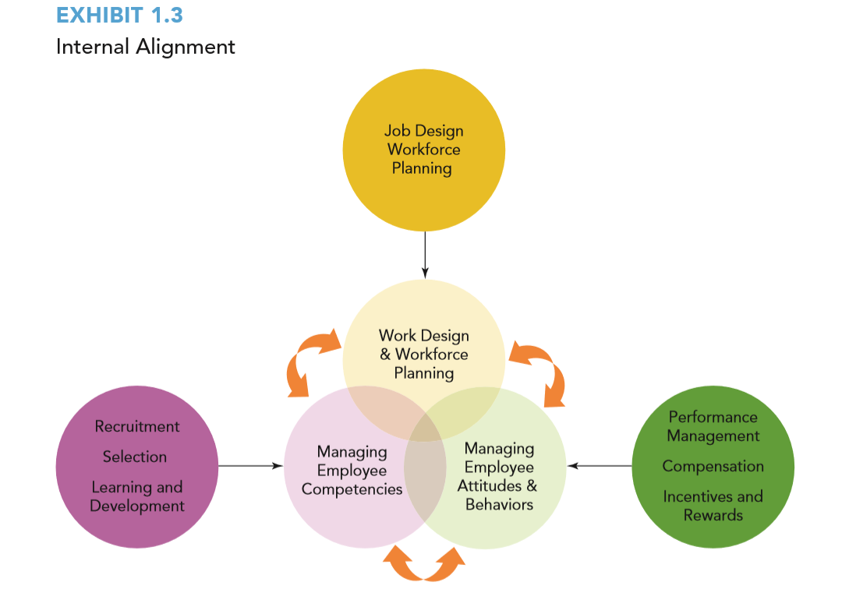
Notes:
Long Description: The diagram consists of six circles. Three circles are overlapping at the center and are given as follows: Work Design and Workforce Planning, Managing Employee Competencies, Managing Employee Attitudes, and Behaviors. Each circle is connected to the other using double-headed curved arrows. An arrow from the circle labeled Recruitment Selection Learning and Development points to Managing Employee Attitudes and Behaviors. Another arrow from the circle labeled Performance Management Compensation, Incentives, and Rewards points to Managing Employee Attitudes and Behaviors. An arrow from the circle labeled Job Design Workforce Planning points to Work Design and Workforce Planning.

Slide 15
Notes:
Long Description: The diagram is titled EXHIBIT 1.4. Four rectangular blocks labeled Strategy, Company Characteristics, Organizational Culture, and Employee Concerns are shown. Arrows from each block point to a block labeled Organizational Demand at the right end.

Slide 16
Company Characteristic Impact On Strategy
Size – small – medium – large - gigantic
Place in the life cycle, e.g. start-up – growth – maturity - decline

Slide 17
Company Culture
National – Regional - Local
Industry
Ethnic
Religious
Professional

Slide 18
Employee Concerns
Psychological contract between employer and employees?
Work/life balance?
Generational issues
Social issues
Perceptions of fairness
Openness to business affairs

Slide 19
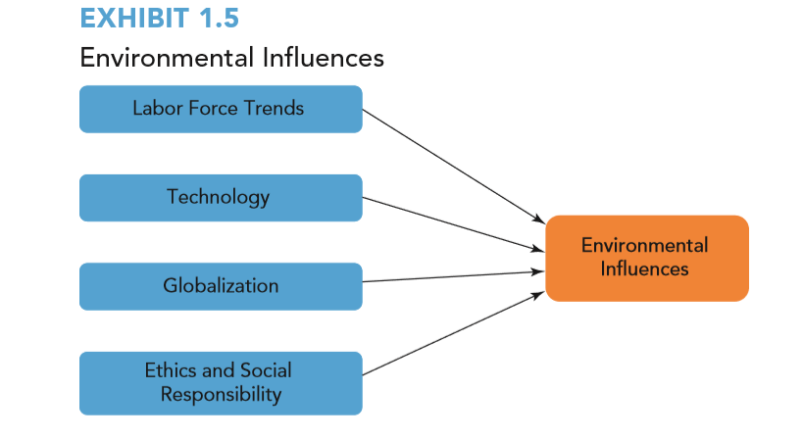
Notes:
Long Description: The diagram is titled EXHIBIT 1.5, environmental influences. Four rectangular blocks labeled Labor Force Trends, Technology, Globalization, Ethics, and Social Responsibility are shown. Arrows from each block point to a block labeled Environmental Influences at the right end.

Slide 20
Labor Force Trends
Generational issues
Having a diverse and inclusive workforce?
Part time – full time – gig - contract

Slide 21
Technology
How is A.I. affecting how and where work is done?
To what extent did technology enable remote work during COVID-19?
Is teleworking the new mode of working for the long-term future? And, if so, what are the pros and cons?
How does technology affect the workforce?

Slide 22
Globalization
Blurs country boundaries and standards in business activities
Enables international joint ventures and partnerships
Challenges companies with differences in values and beliefs
Encourages offshoring—sending work once performed domestically to other countries for lower costs
Competing on an uneven playing field and brutally competitive competition

Slide 23
Ethics and Social Responsibility
To what extent should a company be held accountable for employee behavior?
Why is it necessary for company policies to spell out what constitutes ethical behavior on the part of employees?
How important is a company’s focus on social responsibility in your deciding to work for the company?

Slide 24
Chapter 4 Job Design and Job Analysis

Slide 25
Learning Objectives
After reading this chapter, you should be able to:
Explain how job design and analysis can help an organization achieve a competitive advantage.
Explain the differences between efficiency and motivational approaches to job design.
Apply the principles of the Job Characteristics Model to design a job to increase employee motivation.
Apply job design to make low/unskilled jobs more appealing to workers.
Analyze the advantages and disadvantages of the various sources of information for job analysis.
Explain the advantages and disadvantages of flexible work schedules.
Assess the impact on an organization and the changes required to job descriptions and specifications when employees are working remotely.
Explain the influence of legal requirements on job descriptions and specifications.

Slide 26
The Importance of Job Design and Job Analysis
KSAs are knowledge, skills, and abilities
Managers consciously make decisions about how they design jobs to improve company performance
Critical goal of managing the primary human resources activities is to maximize the employee contributions that yield competitive advantage
Critical role in managing employee attitudes and behaviors

Slide 27
Always Keep in Mind
Job design and descriptions are not written to document all of the activities that an employee does;
They are written to focus on the most critical deliverables that add value to the organization and, ultimately, to the company’s customers.

Slide 28
Job Design
Goal is to enhance company performance
Which tasks should be emphasized?
How simple or complex are these tasks?
How many tasks can employees perform?
How much flexibility is given to employees?
Co-worker interaction?

Slide 29
Practical Exercise
Please conduct a job analysis on the bus driver for Mega bus that travels from SUNY-Albany to NYC and return.

Slide 30
Job Design For Mega Bus Driver For Which He/She Will Be Paid A Salary
Principle KSAs
A.
B.
C.
D.
E.
F.
G.
E.

Slide 31
Job Design For Mega Bus Driver For Which He/She Will Be Paid A Salary
Principle Deliverables
A.
B.
C.
D.
E.

Slide 32
Job Analysis
Definition: Systematically identifying tasks, duties and responsibilities expected to be performed in a job as well as competencies—knowledge, skills, and abilities (KSAs) employees need to be successful.
Outputs are:
Job descriptions
Job specifications

Slide 33
Job Descriptions and Job Specifications
Job descriptions: written summaries of the specific tasks, responsibilities, and working conditions of a job
Job specifications: the specific competencies a jobholder must possess to be able to perform a job successfully
Usually combined into a single document

Slide 34
Job Design: Efficiency Approach (1 of 2)
Key goal is to maximize efficiency; emphasizes standardization of production processes
Time and motion studies systematic evaluation of the most basic elements of the tasks that complete a job
Job specialization the process of identifying the core elements of a job
Repetition increased skill and speed
Job simplification removing decision-making authority from employees and placed it with a supervisor

Slide 35
Job Design: Motivational Approach (2 of 2)
Maximizes employee’s drive to work as hard as possible
Focuses on making jobs more interesting, challenging and complex to encourage employees to want to work as effectively and efficiently as they can
Job Characteristics Model — identified 5 job dimensions and 3 psychological states that affect motivation and satisfaction as well as absenteeism, turnover, and productivity

Slide 36
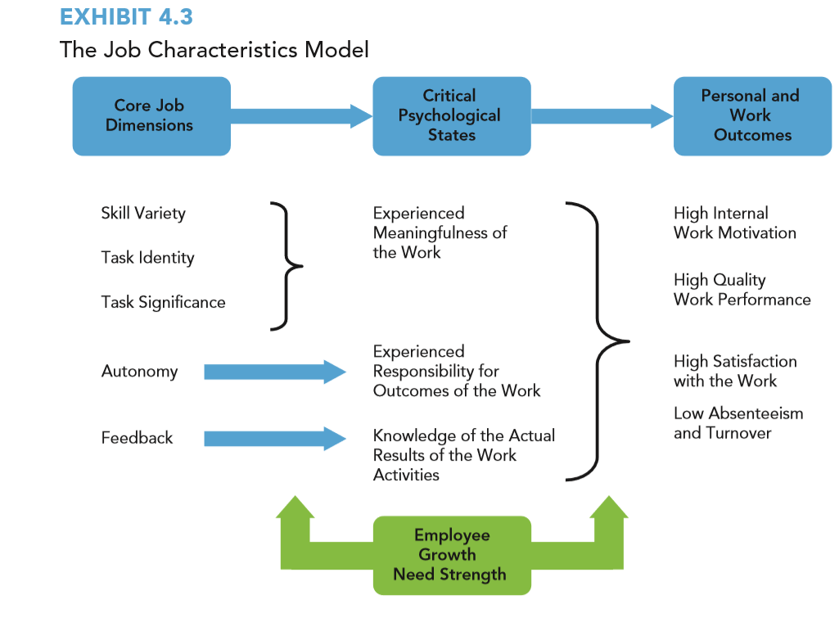
EXHIBIT 4.3 The Job Characteristics Model
Notes:
Long Description: Three rectangular blocks labeled Core job Dimensions, Critical Psychological States, Personal and Work Outcomes are shown. The contents below the Core job Dimensions block are as follows: Skill variety, Tank identity, Tank Significance, Autonomy, Feedback. The contents below the Critical Psychological States block are written within curly braces and are as follows: Experienced meaningfulness of the work, Experienced responsibility for outcomes of the work, Knowledge of the actual results of the work activities. A rectangular block labeled Employee Growth Need Strength is arranged below these contents. The block consists of two upward arrows on the left and right. An arrow from Autonomy points to Experienced responsibility for outcomes of the work. Another arrow from Feedback points to Knowledge of the actual results of the work activities. The contents below the Personal and work outcomes block are as follows: High internal work motivation, High quality work performance, High satisfaction with the work, Low absenteeism and turnover. Skill variety, Tank identity, Tank Significance are written within curly braces.

Slide 37
Growth Need Strength
Growth need strength is the extent to which individuals feel a need to learn and be challenged, a need to develop their skills beyond where they currently are, and a strong need for accomplishment
a.k.a. avoiding extreme boredom

Slide 38
Methods to Improve Employee Motivation and Satisfaction Through Job Design
Approach | Method
Change job tasks | Job enlargement—Assign additional tasks of a similar level of difficulty and responsibility to employees Job rotation—Move workers from one job to another within an organization
Increase responsibility | Job enrichment—Increase the level of responsibility and control regarding tasks performed in job Participation—Permit employees to participate in decisions that may affect them in their jobs Voice—Provide employees with access to formal channels within their company to express concerns about their work situation
Create employee teams | Create small grouping of individuals who work collaboratively toward a common goal and who share responsibilities for their outcomes

Slide 39
Current Research on Job Design
Social aspect of work
Organizational citizenship—optional interaction, required interaction
Organizational citizenship behavior
Creativity
Health and well-being
Bullying and other negative behaviors
Temporary employees
Across cultures
Remote work

Slide 40
Job Analysis Methods for collecting Job Information
Method | Source | Process | Applicable Jobs
Observation | Job analyst | Physical observation or videotaping of employees performing the job;notes are taken or videotape analyzed to determine the main tasks performed | Jobs with repetitive tasks performed over a short cycle, such as an assembly-line position
Dairy/log | Employee | Records activities at specified intervals for a specific time period Information analyzed to identify patterns suggestive of typical types of work performed | Most jobs,May be disruptive to use in retail,manufacturing and construction
Interview | Job analyst/employee | Face -to-face question and answer session to identify tasks,duties,responsibilities Competencies and working conditions | Most jobs,especially at the managerial and professional level.Time consuming and costly
Questionnaire | Employee | Written survey instrument administered in a group setting or individually.can be done electronically. Ensures that standardized information is collected | All jobs.literacy of participants can affect the quality of information collected
O*NET | Occupational Information Network | Online database (www.online.onecenter.org)of more than 1,000 occupations | All jobs. Customization of jobs to specific company

Slide 41
Job Description Approach
What is the employee expected to achieve that adds value to his/her work and justifies the salary that he/she is being paid?
Achieving vs. doing

Slide 42
Job Descriptions
FORMAT
What are the five (+/-) most critical achievables that add value to your job and justifies the salary you are paid for this work.
What are the performance criteria to which you will be held accountable
What are the measurement standards which will be used to evaluate your performance.

Slide 43
Job Descriptions
Qualifications
Required: e.g. licenses, certifications, academic, physical, availability, clean driving record, etc.
Desired: computer knowledge, 2nd language, customer service,

Slide 44
Job Descriptions
5. Administration
Salary/wage
Title
Reports to
Direct reports
FLSA category (i.e. exempt/non-exempt)
Location
Other job identifiers

Slide 45
Current Research on Job Design
Social aspect of work
Organizational citizenship—optional interaction, required interaction
Organizational citizenship behavior
Creativity
Health and well-being
Bullying and other negative behaviors
Temporary employees
Across cultures
Remote work

Slide 46
Job Design in Practice: Environmental Influences
Labor force
Skill availability to perform tasks
Job design decisions for the aging labor force
Technology
Remote work
Virtual teams

Slide 47
Job Design in Practice: Environmental Influences
Globalization
Need to address cross-cultural issues
Relevant labor markets
Ethics/social responsibility
Concerns about types of tasks required
Attitudes toward physical conditions of job design

Slide 48
Job Design in Practice: Regulatory Issues
Importance of Identifying Essential and Nonessential Job Duties
Americans with Disabilities Act (ADA)
Reasonable accommodation
Job Design and Employee Safety
Occupational Safety and Heath Act (OSHA)

