Slide 1
CIT Conference – SUNY Oneonta – Oneonta, NY
June 2, 2017
Student Panel: Hear What Students Have to Say About F2F, Web-Enhanced, and Online Classes
David Mamorella, Adjunct Professor / Instructional Developer
Runjie Wang, Class of 2018
Ashley Christman, Class of 2019
Ashley Stock, Class of 2019 https://www.surveymonkey.com/r/GMKRZ8Q

Slide 2
Audience Analysis
Have you taken an online class?
Have you taught an online class?

Slide 3
Agenda
First Impressions
Student Expectations of Professors
Benefits of Blackboard
Learning Styles, Motivational Factors
Teaching Styles & Learning Environments
F2F vs Online Classes
Takeaways
Q & A

Slide 4
Professor Photo - First Impressions?

Slide 5
Student Expectations of Professors
Knowledge of the subject
Treat all students fairly and with respect
Course is organized in a logical manner
Provide clear expectations, due dates, policies
Student-Centered: Encourage student engagement
Seek student input
Students know their grades

Slide 6
Student Expectations of Professors
Respond to student emails in a timely manner
Give substantive feedback
Available outside of class
Cares about teaching and wants students to learn
Varied ways of assessing learning
Use Blackboard and Technology in some way

Slide 7
Instructors Lose Credibility with Students
Show up late for class
Lack familiarity with assigned readings
Unable to explain difficult concepts
Rarely see if students understand the instructor’s explanations
Do not make an attempt to answer student questions
Provide unclear expectations and vague answers to student questions about course policies, tests, assignments
Fail to follow course policies outlined in syllabus
Fail to remind students of upcoming deadlines & due dates
Reported in Therese Huston, Teaching What You Don’t Know

Slide 8
Benefits of Blackboard
Do you expect your professors to use Blackboard?
What percentage of your professors use it?
Advantages and Challenges using Blackboard

Slide 9
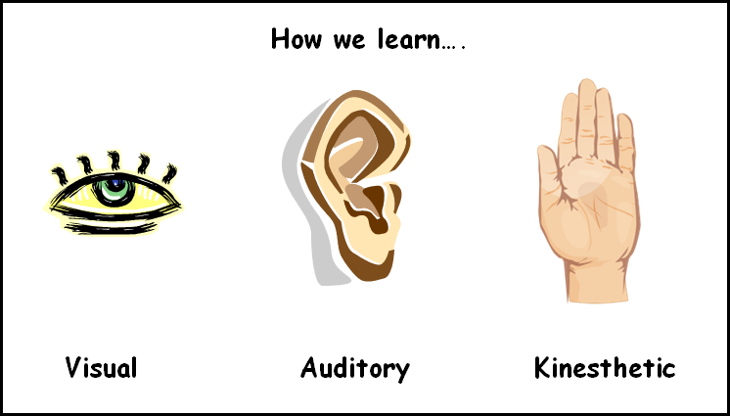
Learning Styles

Slide 10
Follow Along and Do as I Say
People usually pay more attention to what they see than what they hear, yet many instructors just lecture.

Slide 11
What Impacts and Motivates Students to Learn?

Slide 12
Teaching Styles & Learning Environments
Lecture Hall vs Smaller Classes
Teacher-Centered vs Student-Centered
Student Engagement

Slide 13
How does an engaging class impact your learning?
Student Comments
Captures my attention
Helps me understand and retain information longer
Getting me involved makes me want to come to class, makes me want to participate.
Encourages me to voice my opinion
We, as in students, have a short attention span, so it helps keep us awake.

Slide 14
How does an engaging class impact your learning?
Student Comments
Encourages me to not only learn but also do well in classes.
I am able to hear what others have to say as well as how my opinions relate/differ from my peers.
Makes a more comfortable learning environment
Gives you a sense of responsibility and belonging

Slide 15
Student Engagement
Icebreakers, Getting Acquainted, Classroom Activities
Clickers
Group Work

Slide 16
F2F vs Online Classes
Perception of Online Classes vs Reality
Advantages and Challenges with Online Classes
Assess Your Learning
Online Discussions
Online Tests / Academic Honesty
Overall Learning

Slide 17
Perceptions vs Reality
What are your perceptions of online classes?
How did the online workload compare to F2F?
Student Comments
100% depends on the professor. I was pleasantly surprised that there was no "busy work" for this online class.
Burden of learning falls more on the students. The professors acted more like facilitators of independent study and as graders.
Did the bare minimum required in order to pass the class.

Slide 18
Audience Poll Questions
Would you prefer to take a class F2F or Online?
What was your perception of online classes BEFORE you took one?
Did you have more work F2F or Online?
https://www.surveymonkey.com/r/GMKRZ8Q
https://www.surveymonkey.com/results/SM-YFB6Y8GH/

Slide 19
Advantages of Online Classes

Slide 20
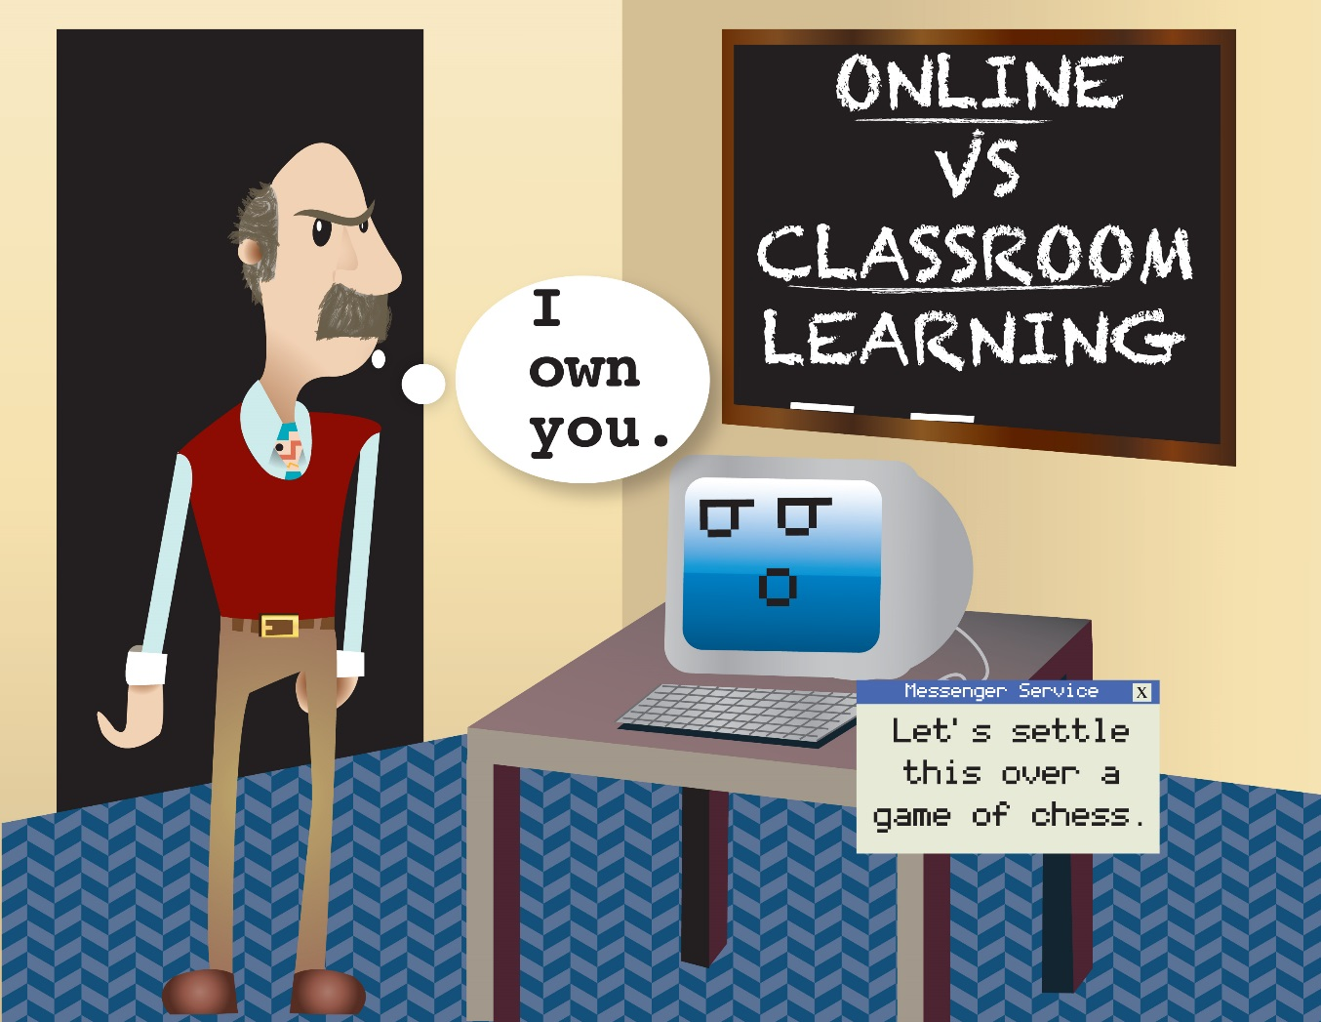
Challenges with Online Classes

Slide 21
Audience Poll Question
What did you dislike or find most challenging about taking an online class?
https://www.surveymonkey.com/r/GMKRZ8Q
https://www.surveymonkey.com/results/SM-YFB6Y8GH/

Slide 22
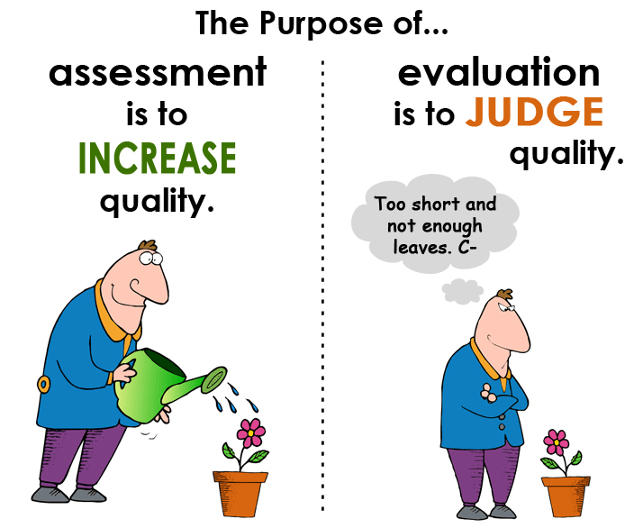
How do you prefer to be assessed?

Slide 23
Online Discussions
What are your thoughts about online discussions?
Student Comments
You have more time to carefully think about content in absorbing and creating responses from self and others.
Not all subject merit discussion and not all subjects are broad enough in scope to allow for extensive discussion.
Discussions really help me cement concepts in my mind.
Discussions helped a lot and forced me to come up with an opinion.
Depends on the interest level of the class and discussion.

Slide 24
Online Tests / Academic Honesty
What are your thoughts about taking online tests?
How I detected two students cheated taking an online test

Slide 25
Audience Poll Questions
According to research, do students score higher taking a test F2F or Online?
According to research, how does cheating compare F2F vs Online?
https://www.surveymonkey.com/r/GMKRZ8Q
https://www.surveymonkey.com/results/SM-YFB6Y8GH/

Slide 26
Test Scores: F2F vs Online
No Significant Difference

Slide 27
Cheating - Inconclusive Findings
Academic dishonesty online is no more pervasive than F2F (Grijalva, Nowell, & Kerkvliet, 2006).
Cheating was much more prevalent online compared to F2F (Lanier, 2006).
Online students were less likely to cheat than F2F (Stuber-McEwen, Wiseley, & Hoggatt, 2009).
635 undergrad/grad students at a university showed higher rates of academic dishonesty in F2F (Watson & Sottile, 2010).

Slide 28
F2F vs Online: Overall Learning
Did you learn more F2F or Online?
Student Comments
This can go both ways, depending on the specific course and instructor.
Depends on the class, but a lot of material was learned for the short-term, compact 4 weeks classes and subsequently forgotten.
Depends very strongly on the course content. I took the Middle Ages on Film, where I learned more than I would have done in the classroom, I feel. Introduction to Western Civilization, I definitely learned less. History of England, about the same.

Slide 29
Takeaways
What are your thoughts of being on this panel as a learning experience?
What is your biggest takeaway from college so far?

Slide 30
Questions
David Mamorella dmamorella@albany.edu
Runjie Wang rwang21@albany.edu
Ashley Christman achristman@albany.edu
Ashley Stock amstock@albany.edu
http://www.albany.edu/faculty/dmamorella/cit2017.html

