Slide 1
(some of) My Research
Engineering is about getting technology to do what it does well
so humans can do
what they do well
Jeff Offutt
Professor of Software Engineering
https://www.cs.gmu.edu/~offutt/

Slide 2
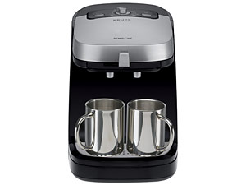
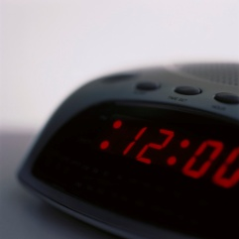
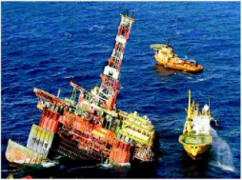
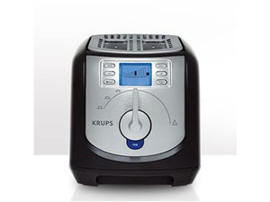

Software is the nervous system of our civilization
Quote partially due to Dr. Mark Harman

Slide 3

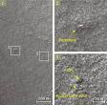
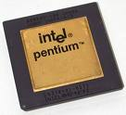
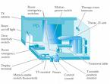
Spectacular software failures
NASA’s Mars lander : September 1999, crashed due to a units integration fault
Ariane 5:
exception-handling
bug : forced self
destruct on maiden
flight (64-bit to 16-bit
conversion: about
370 million $ lost)
Mars Polar
Lander crash
site?
Toyota brakes : Dozens dead, thousands of crashes
Major failures : Ariane 5 explosion, Financial engines, Intel’s Pentium FDIV bug
Poor testing of safety-critical software can kill :
  THERAC-25 radiation machine: 3 dead
THERAC-25 design
Northeast blackout : 50 million people, $6 billion USD lost … alarm system failed
Software testers try to find faults before the faults find users

Slide 4
What is testing & why is it hard?
A program can have quadrillions of inputs.
And will work correctly on most!
If a million inputs trigger the fault.
Only .00000000025 chance of finding it randomly ...
Software testers
design test inputs to trigger faults before they get to users

Slide 5
Cost of testinglate
60
50
40
Fault
origin (%)
Detected (%)
Unit cost (X)
30
20
10
0
Requirements
Prog / Unit Test
Design
Integration Test
System Test
Post-Deployment
Unit testing saves a LOT of money
Notes:
28-Oct-2010, at GTAC, added the animation to demonstrate increasing the number of faults found early, thereby decreasing the number of faults found late, and finally saving money. Lots of it! This animation is fairly complicated … must practice first!!

Slide 6
What do testing researchers do?
Software testing researchers
invent clever ways to design inputs that will find software faults
Build software tools to create tests
Run experiments to find out how well the testing ideas work
Tell industry how to use the ideas
Teach students – the next generation of software testers

Slide 7
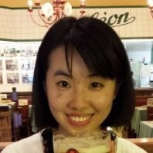
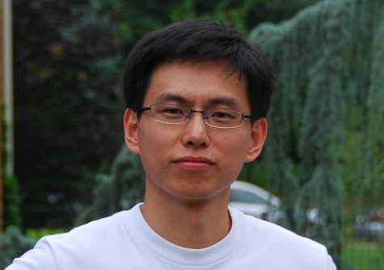
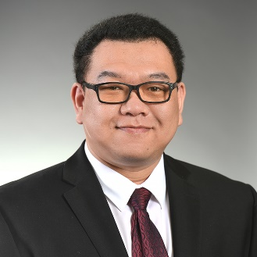
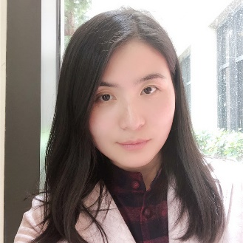
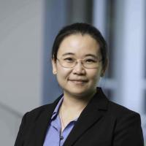
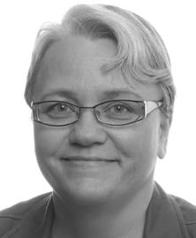
A few recent PhD students
Towards automatically localizing and repairing SQL faults, 2018, Cvent
Generating cost-effective criteria-based tests from behavioral models, 2014, Medidata Solutions
Mutation testing for android apps, 2017, Towson University
Towards evasive attacks: Anomaly detection resistance analysis on the Internet, 2013, Intuit
Testing web applications with mutation analysis, 2017, University of Virginia
Testability of dynamic real-time systems, 2009, University of Skövde

Slide 8
Model-based testing process
Test criterion
Test requirements (subpaths)
Abstract tests (test paths)
Concrete tests
Test oracles
Model
Criterion
Test Requirements
Abstract Tests
Concrete Tests
Extra Info
Test Execution
Test Reports

Slide 9
Test oracle strategies
28,881,000 test executions
% faults found that the oracle revealed
More precise OSes are not always more effective

Slide 10
Test oracle strategy findings
Crash testing (NOS) wastes testing effort
Penny wise, pound foolish
We should check state invariants (SIOS)
Only one check needed
Can be partially derived automatically from the model
A lot of JUnit test assertions are broken—they do not check the right thing
Joint work with Dr. Nan Li

Slide 11
Current research—smart tests
Old style tests
Values invented by humans
Scripts were pieces of paper with steps
  Turn on computer
  Type : “Run myProgram”
  Enter name : “George P. Burdell”
  Enter age : “-25”
Simple directions to humans
Slow!
Error prone!
Limited repeatability!
These tests are as dumb as single-cell organisms !!
Almost impossible to use test criteria

Slide 12
Modern dumb tests
Test values
  Created by a mix of humans and test data generators
  Satisfy well-documented goals, test criteria, or specialized domain needs
Integrated into automated test scripts (eg, JUnit)
Includes a small amount of brain power … these tests know what results to expect (eg, JUnit assertions)
Fast … repeatable …
These multi-cellular tests show the first signs of intelligence!

Slide 13
Multicellular tests
But this test does not know …
Before values
Test values
After values
Why is it there?
Expected results
When should it run?
When should it change?
When should it die?

Slide 14
Intelligent tests
Self-awareness
Self-determination
Each test should encode traceability … what it covers
Tests should check what has changed, and rerun if necessary
Tests should alert tester when they no longer match the software
Tests should quietly go away when no longer needed

Slide 15
Google’s motto
Debugging sucks
Testing rocks
Jeff Offutt
https://cs.gmu.edu/~offutt/

